Slide 1
CHAPTER 6
Managing and reporting working capital

Slide 2
Learning objectives
After this chapter, students will be able to:
Define working capital and explain why its management matters.
Apply liquidity ratios to evaluate a business’s short‑term financial health.
Explain the importance of managing cash receipts and payments.
Understand how to monitor and control accounts receivable.
Identify key control procedures for inventory.
Explain the need to manage accounts payable effectively.

Slide 3
Why businesses fail?
According to Michael E Gerber, accounting issues are the basis for three of the top 10 reasons why small businesses, in particular, fail. They are:
a lack of management systems, such as ﬁnancial controls
a lack of ﬁnancial planning and review
an inadequate level of ﬁnancial resources (lack of money)

Slide 4
6.1 Working Capital
What is Working Capital?
Working capital represents the short‑term resources a business uses in its day‑to‑day operations.
Working Capital = Current Assets – Current Liabilities
Key current assets:
Cash
Accounts receivable
Inventory
Prepayments
Accrued income
GST paid
Key current liabilities:
Accounts payable
Accrued expenses
Income received in advance
PAYE payable
GST received

Slide 5
The working capital cycle
A business converts:
Cash → Inventory → Sales → Accounts Receivable → Cash
Suppliers provide inventory on credit (accounts payable), customers buy on credit (accounts receivable), and cash flows back into the business.
Cash
Cash
Suppliers
- Accounts Payable
Customers
- Accounts Receivable
Suppliers
- Accounts Payable
Customers
- Accounts Receivable
Inventories
Inventories

Slide 6
Why working capital management matters
Businesses must balance:
Having enough working capital to operate smoothly and handle unexpected needs.
Avoiding excess cash, inventory, or unused credit, which reduces profitability.
Managers use internal controls to ensure assets are safeguarded and operations run efficiently.

Slide 7
WORKING CAPITAL
= Current Assets – Current Liabilities
CONSIDER THE FOLLOWING EXTRACTS FROM Two BALANCE SHEETS

Slide 8
Ratios
Ratio analysis is where an item on the business’s financial statements is divided by another related item
Ratios are used to compare a business’s financial position with previous periods and with other businesses
Ratios are used in Financial Statement Evaluation (Week 7)

Slide 9
CURRENT RATIO
= Current Assets/ Current Liabilities
Current Ratio A:150,000/50,000 = 3
Current Ratio B: 60,000/50,000 = 1.2
Shows the ability of the firm to meet obligations in the ordinary course of business
For every $1 which needs to be paid, Company A has $3 of current assets. Company B has only $1.20

Slide 10
QUICK RATIO
=Quick assets/Current liabilities
Where Quick = Cash, short term securities and notes and accounts receivable
Quick Ratio Company A:
  (60,000+40,000)/50,000 = 2
Quick Ratio Company B:
  (20,000+10,000)/50,000 = 0.60
Show the ability of the firm to meet obligations if put under pressure to do so.
For every $1 dollar owed, company A has $2 of quick assets. Company B has only 60 cents

Slide 11
6.2 Cash
Cash is anything that a bank will accept as a deposit.
Simple cash controls: controls over cash receipts and cash payments.
Controls Over Cash (Ref. Exhibit 6.3 for details)
Segregation of duties
Daily banking of receipts
Authorization of payments
Use of pre‑numbered documents
Bank Reconciliation (preparation of a bank reconciliation is not part of this course)
Compares the business’s cash records with the bank statement to identify timing differences and errors.
Petty Cash
A small fund for minor payments when using the bank account is impractical.

Slide 12
6.3 Accounts receivable
Accounts receivable are the amounts owed to a business by customers from previous credit sales.
The decision to extend credit to an individual:
Credit Approval - Applications typically include:
Employment and income details
Bank information
Assets and debts
Credit history
For companies: director details and financial statements
Controls Over Accounts Receivable
Grant credit only to approved customers
Monitor customer balances
Use clear credit terms (e.g., 2/10, net 30)
Monitor total receivables regularly

Slide 13
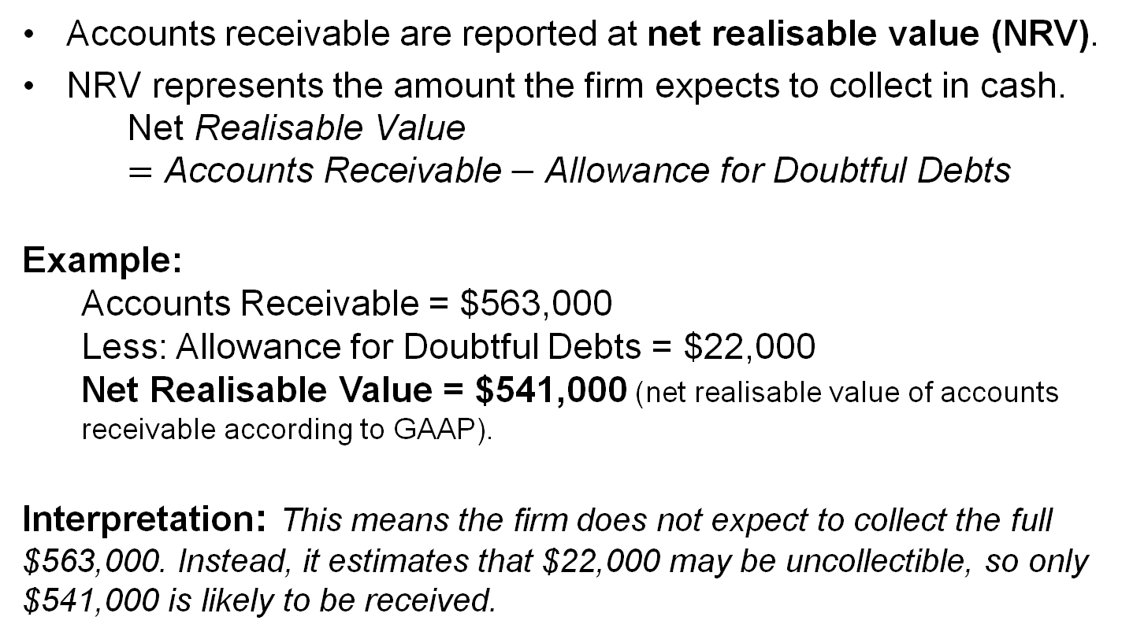
6.3 Accounts receivable – Reporting
Accounts receivable are reported at net realisable value (NRV).
NRV represents the amount the firm expects to collect in cash.
$$\text{Net} \text{Realisable} \text{Value}=\text{Accounts} \text{Receivable}−\text{Allowance} \text{for} \text{Doubtful} \text{Debts}$$
Example:
Accounts Receivable = $563,000
Less: Allowance for Doubtful Debts = $22,000
Net Realisable Value = $541,000 (net realisable value of accounts receivable according to GAAP).
Interpretation: This means the firm does not expect to collect the full $563,000. Instead, it estimates that $22,000 may be uncollectible, so only $541,000 is likely to be received.

Slide 14
6.4 Inventory
Inventory is the merchandise being held for resale.
Simple inventory controls
  controlling the ordering and acceptance of inventory deliveries
  establishing physical controls over inventory while the inventory is being held for sale
  periodically taking a physical count of its inventory to ensure accurate inventory records.
Cost of Inventory
Businesses must determine:
- Cost of goods available for sale
- Cost of goods sold
- Ending inventory

Slide 15
Inventory: Cost flow methods
FIFO (first‑in, first‑out)
LIFO (last‑in, first‑out)
Weighted average
Specific identification
FIFO: You sell the oldest item first.
Cheapest cost goes to COGS → higher profit
Newer, more expensive items remain in inventory.
LIFO: You sell the newest item first.
Highest cost goes to COGS → lower profit
Older, cheaper items remain in inventory.
Average Cost: You take the average cost per unit and apply it to both COGS and ending inventory.
Specific Identification: You know exactly which item was sold (e.g., serial numbers). COGS depends on the actual item sold.

Slide 16
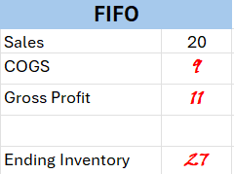
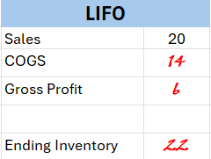
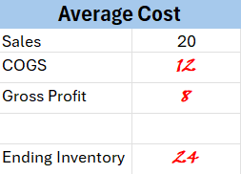
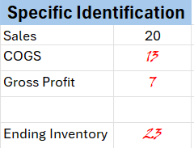
Inventory Valuation Methods
A business purchases three units of inventory during May:
Date | Units | Cost per Unit
May-10 | 1 | $9
May-18 | 1 | $13
May-24 | 1 | $14
Total | 3 units | $36 total cost
The business sells one unit on May 30 for $20.
Using different inventory valuation methods, calculate the followings:
a. Cost of Goods Sold (COGS); b. Gross Profit; c. Ending Inventory

Slide 17
6.5 Accounts payable
Accounts payable are the amounts that a business owes to its suppliers for previous credit purchases of inventory and supplies.
Simple controls over accounts payable:
establishing control over who can obligate the business
establishing controls over payments
monitoring the total amount of accounts payable.

Slide 18
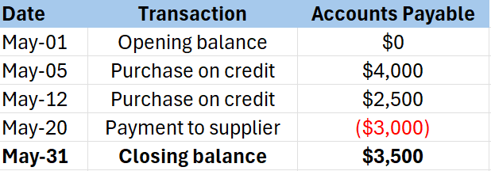
Accounts payable in action!
Café Revive purchases coffee beans and café supplies from its supplier, DFC, on credit.
Transaction Details:
May 5: CR purchases $4,000 of coffee beans on credit. → Accounts Payable increases by $4,000
May 12: CR purchases $2,500 of cups and packaging on credit. → Accounts Payable increases to $6,500
May 20: CR pays $3,000 to DFC. → Accounts Payable decreases to $3,500
Café Revive still owes $3,500 to its suppliers at the end of May. This amount appears on the balance sheet as a current liability. Paying suppliers on time helps maintain good relationships and ensures continued supply.

Slide 19
What is the cash conversion cycle (CCC)?
CCC measures how long it takes for a business to convert cash spent on operations back into cash received.
A typical business:
Uses cash to purchase inventory
Sells inventory (often on credit)
Waits for customers to pay
Formula: CCC = DIO + DSO – DPO
CCC = Days Inventory Outstanding (DIO) + Days Sales Outstanding (DSO) - Days Payables Outstanding (DPO)

Slide 20
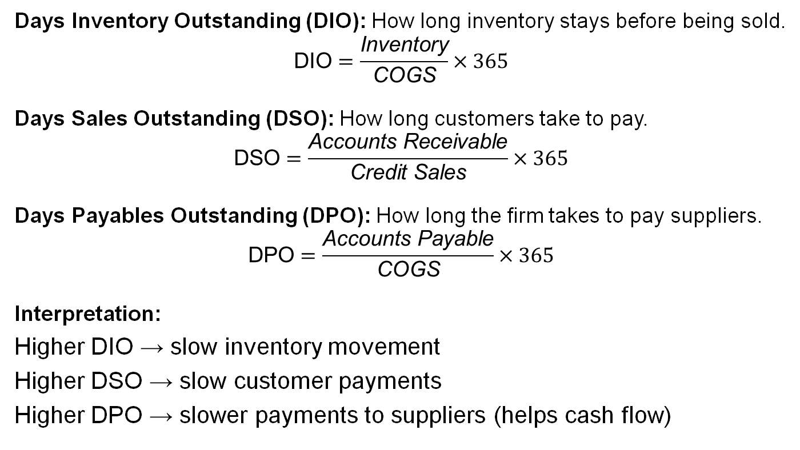
Components of the CCC
Days Inventory Outstanding (DIO): How long inventory stays before being sold.
$$\text{DIO}=\frac{\text{Inventory}}{\text{COGS}}×365$$
Days Sales Outstanding (DSO): How long customers take to pay.
$$\text{DSO}=\frac{\text{Accounts} \text{Receivable}}{\text{Credit} \text{Sales}}×365$$
Days Payables Outstanding (DPO): How long the firm takes to pay suppliers.
$$\text{DPO}=\frac{\text{Accounts} \text{Payable}}{\text{COGS}}×365$$
Interpretation:
Higher DIO → slow inventory movement
Higher DSO → slow customer payments
Higher DPO → slower payments to suppliers (helps cash flow)

Slide 21
Why CCC matters (with managerial implications)
Why CCC is important
Focuses on cash timing, not accounting profit
Long CCC → cash tied up too long
Short CCC → efficient working capital management
Managers aim to:
Reduce DIO → better inventory control
Reduce DSO → faster customer payments
Increase DPO → delay payments (within reason)
Trade‑offs
Too little inventory → stockouts
Strict credit terms → fewer sales
Paying suppliers too late → damaged relationships
Advanced Insight: Some firms (e.g., supermarkets, online platforms) achieve negative CCC. They receive cash before paying suppliers!@

Slide 22
6.6 Working capital: business issues and values
How aggressive should a business be in managing its working capital?
The ethics of aggressive working capital management.
Managing working capital is critical for both the present liquidity and the longer-term sustainability of the business.

Slide 23
Key takeaways
Understand working capital and why is it important.
Be aware of how to manage cash.
Know about reconciliation of the business’s cash record with the bank statement.
Be aware of monitoring accounts receivable to ensure cash flow.
Understand inventory and the impact of payments for inventory.
Understand accounts payable and the importance of paying accounts on time.

